Slide 1
Project Title: [ECO PULSE – SMART CAMPUS INNOVATION]
VIBEAITHON-2025
Team INNOVEZ | CIEL Kingston vibeAIthon 2025

Slide 2
Problem Recap & Objective
Problem Recap:
Campuses face constant energy, water, and waste inefficiencies due to a lack of real-time monitoring and awareness.
Sustainability data remains invisible to students and staff, making it hard to act or measure impact.
Key User Pain Point:
Users have no clear visibility of their individual or collective resource consumption, and existing systems fail to engage or motivate eco-friendly behavior.
Objective of the Prototype:
To create an intelligent, interactive platform that visualizes campus sustainability data in real time, predicts inefficiencies, and encourages active participation through gamification and AI-driven insights.
Expected Outcomes / Success Metrics:
20–40% reduction in resource wastage through predictive monitoring
Active participation of 70%+ campus users in eco-challenges
Real-time visibility into energy and water consumption

Slide 3
Prototype Overview
Description:
EcoPulse is a smart campus prototype that visualizes real-time energy, water, and waste data using IoT sensors and AI analytics. It displays live dashboards, predicts inefficiencies, and engages users through eco-challenges and leaderboards.
Technology Stack:
ESP32 sensors | Node.js | Firebase | React.js | Python (AI) | AR.js / Three.js
Prototype Type:
Functional prototype with simulated IoT data, interactive dashboards, and clickable UI elements demonstrating live updates.
Visuals:
3D Campus “Pulse” dashboard view
AI-powered anomaly alerts
Gamified Green League leaderboard

Slide 4
User Experience & Impact
User Journey:
Students and staff log in to the EcoPulse dashboard to view real-time energy and water usage, receive AI alerts, and track eco-scores.
Key Features:
Live campus dashboard with energy and water metrics
AI-based predictions and anomaly alerts
Gamified Green League and eco-badges
Unique Innovation:
EcoPulse turns sustainability data into an interactive, visual, and gamified experience—making resource efficiency engaging and measurable.

Slide 5
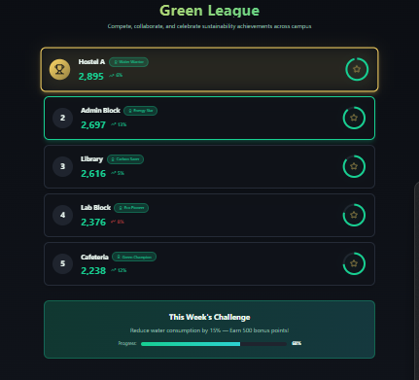
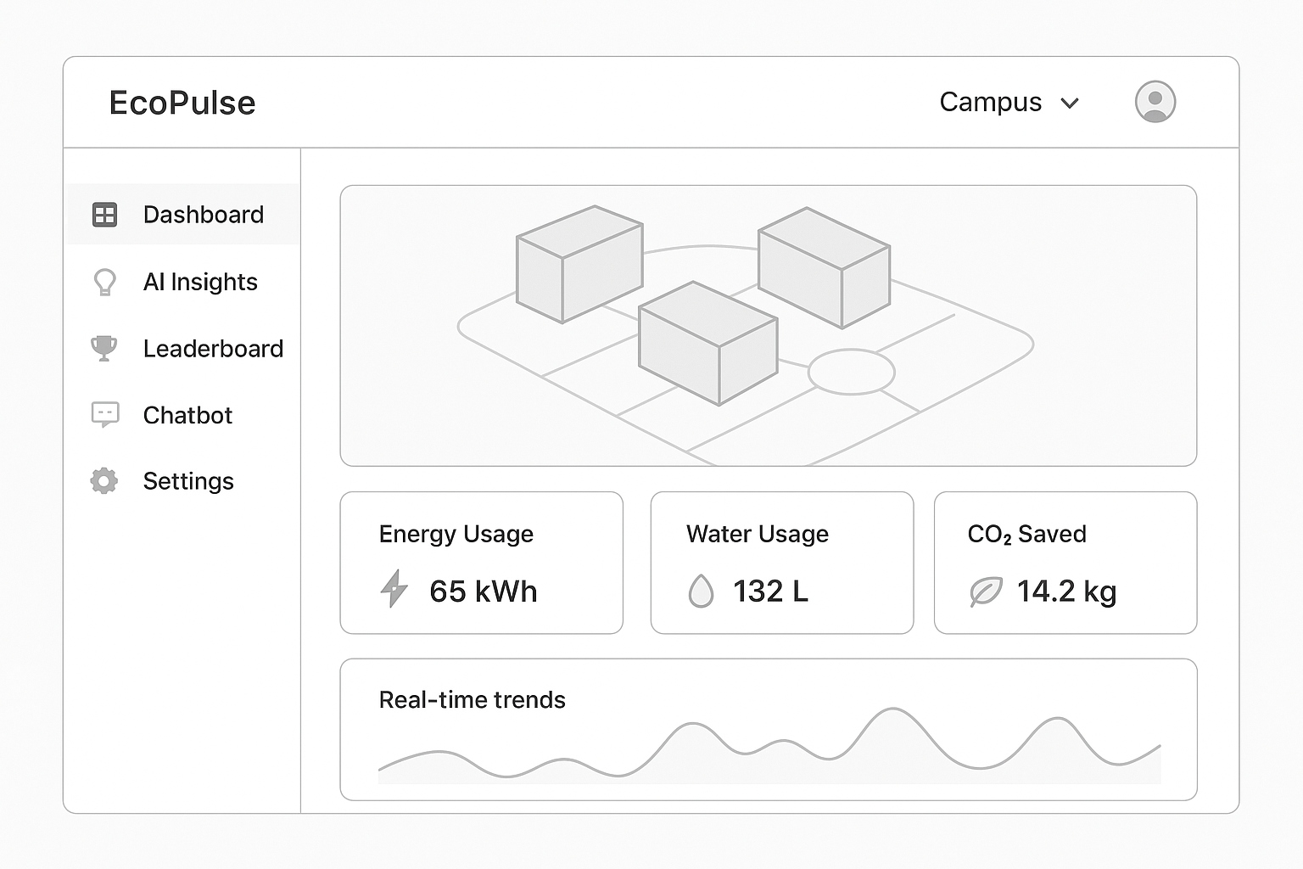
Screenshots & Wireframes
--
--
--
--
--
--
--
--

Slide 6
Thank You

